Slide 1

TISSUE RENEWAL, REGENERATION AND REPAIR
Indah Yulianto., Yuyun Rindiastuti., Titik F Moertolo.

Slide 2
Goal of The Wound Healing
Cotran et al. 1999, Majno & Joris 2004
Cotran et al. 1999, Majno & Joris 2004
Cotran et al. 1999, Majno & Joris 2004
Reconstruction of :
Original Architecture
Function of the injured tissue.
(Cotran et.al. 1999., Majno & Joris 2004)

Slide 3
Tissue Wound Healing
Repair
Regeneration
(Majno & Joris 2004, Kumar et al. 2009)

Slide 4
Tissue Repair
Replacement of injured tissue by different tissue, usually by fibrosis or scar
(Kumar et al. 2009, Majno & Joris 2004)

Slide 5
Tissue Regeneration
Replacement of injured tissue by the same resident cells, or by differentiation of progenitor/stem cells into tissue committed cells.
(Kumar et al. 2009, Majno & Joris 2004)

Slide 8
Adipocyte Stem Cells

Slide 9
Human Stem Cells Transplantation
Autologous
Allogeneic : from individuals belonging to the same species but genetically dissimilar (and hence immunologiccally incmpatible)
Syngeneic : between geneticcally identical individual (tween)
Xenogeneic : From individuals of different species (hence of disparate cell type)

Slide 13
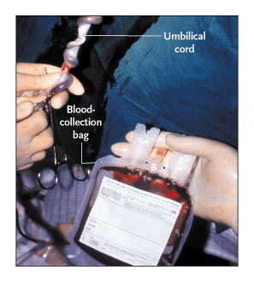
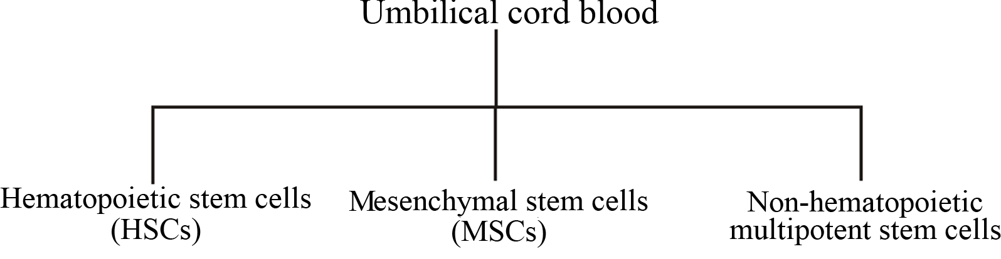

Slide 14
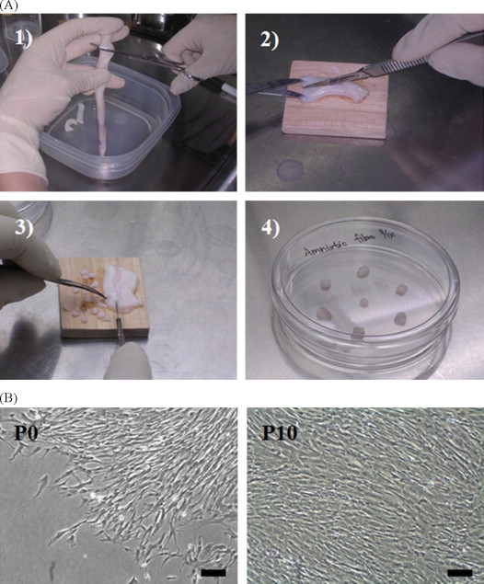

Slide 15
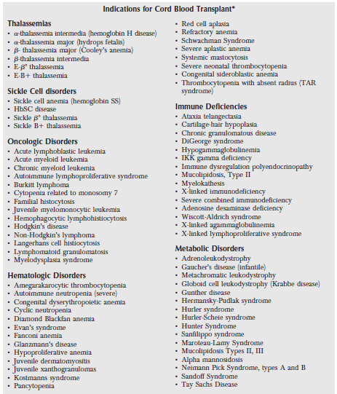

Slide 16
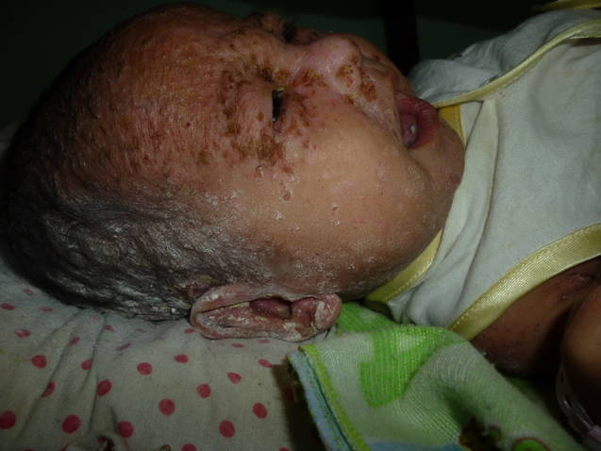
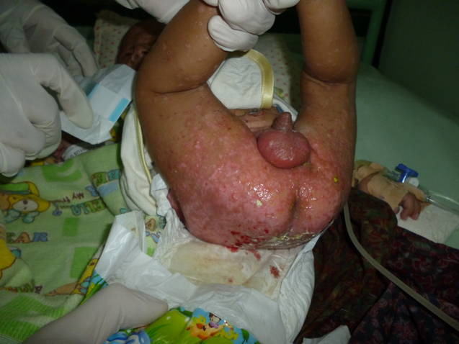
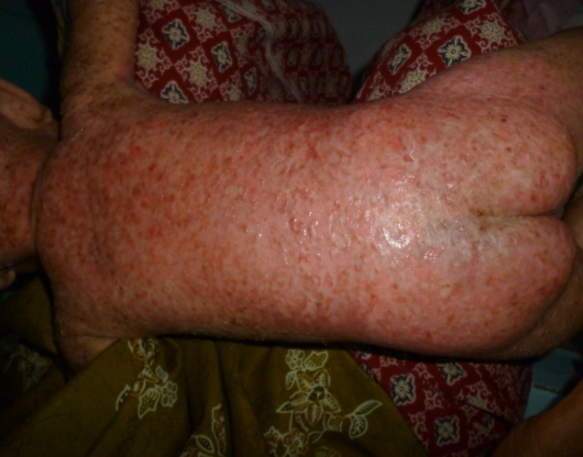
Langerhans Cells Histyocytosis
(Oncology Case – Baby 2 months)
Topical & IV : HUVEC Secretomes
BEFORE THERAPY

Slide 17
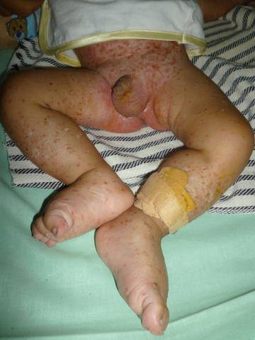
1 week after Treatment : TOPICAL & IV

Slide 18
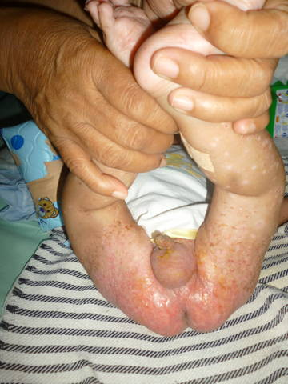
After Treatment Topical & IV 0,2 cc

Slide 19


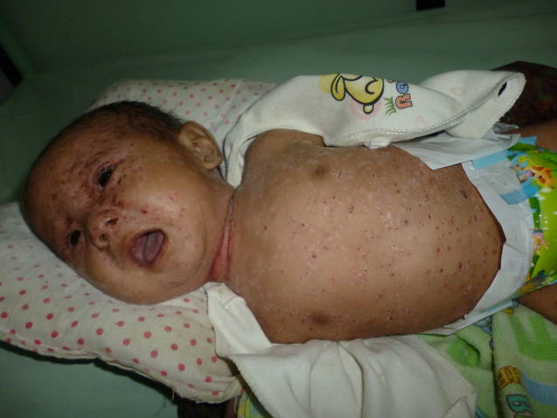
BEFORE and AFTER (1 WEEK)

Slide 20

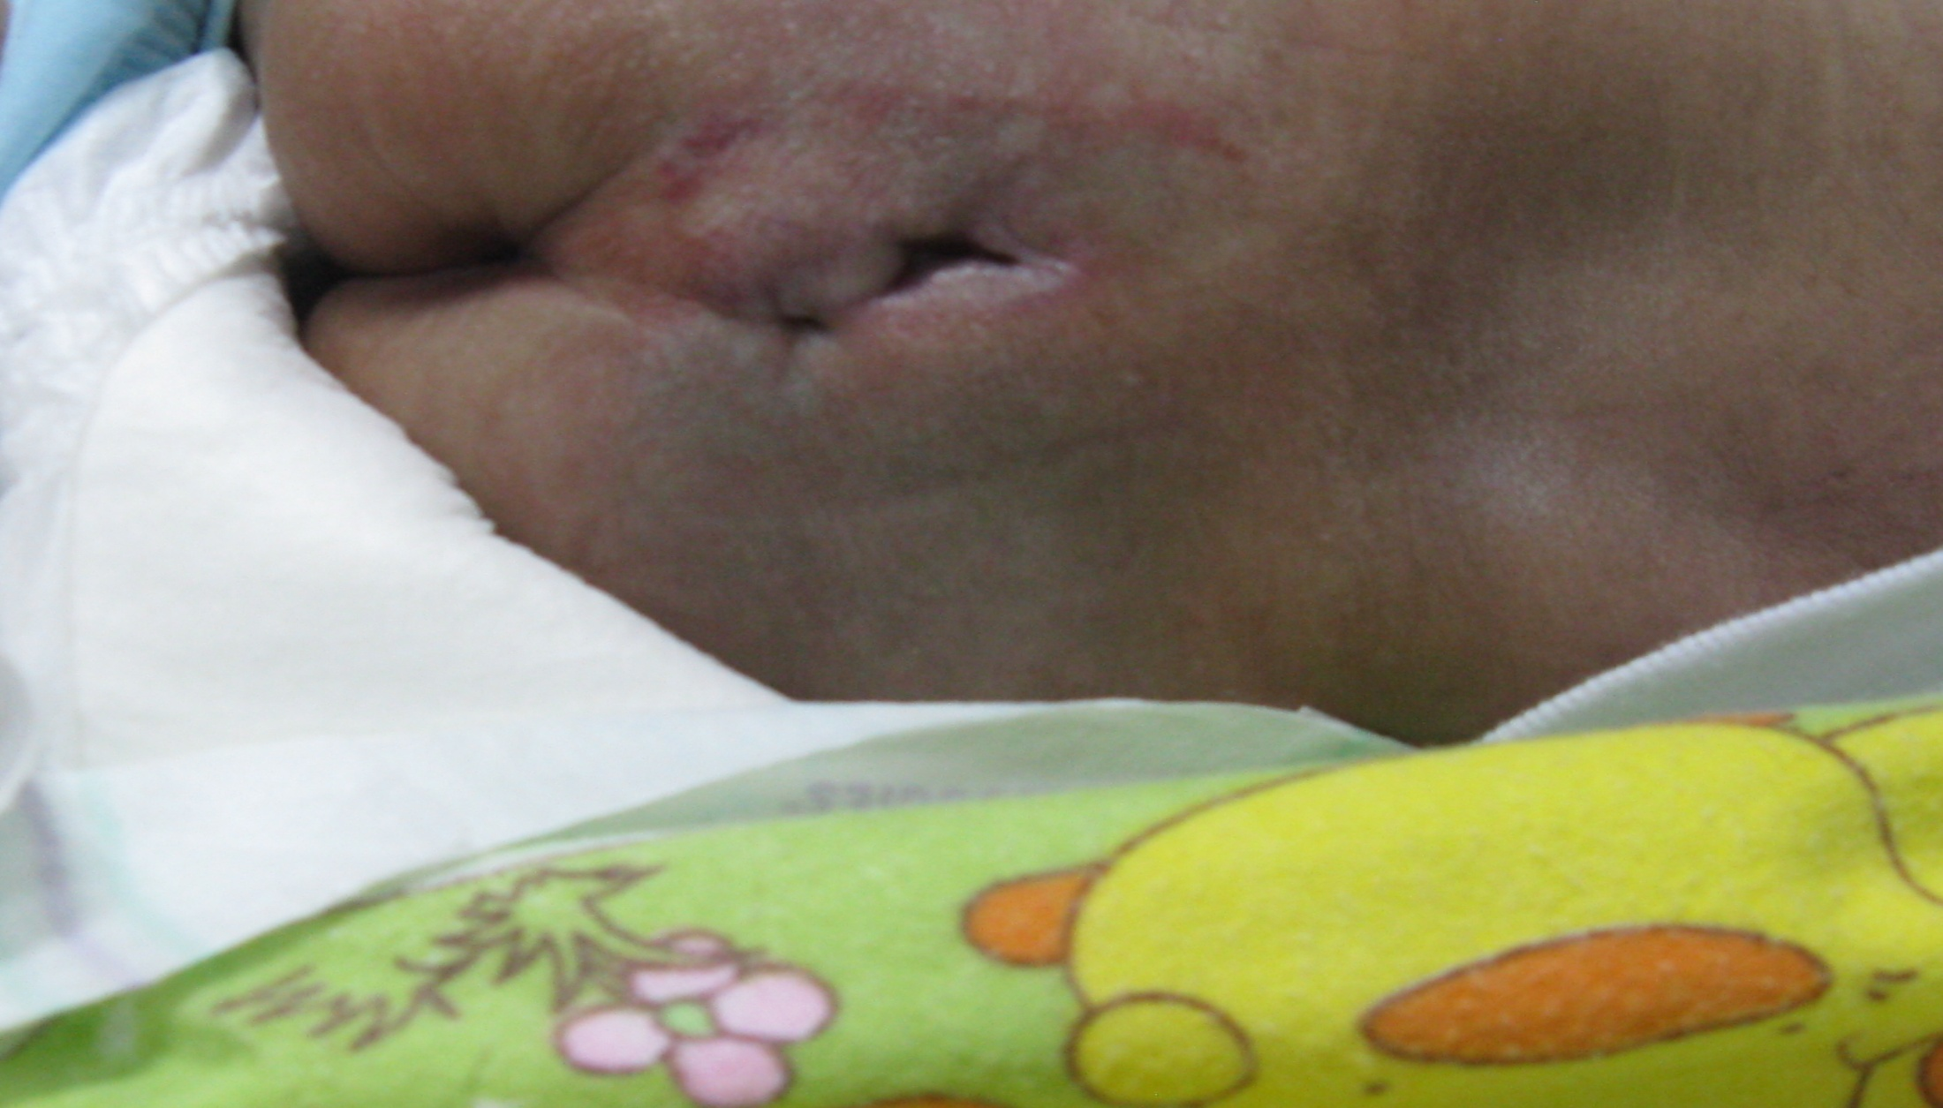
OUR EXPERIENCE
Infant 2 weeks, with fistula supra ani

Slide 21

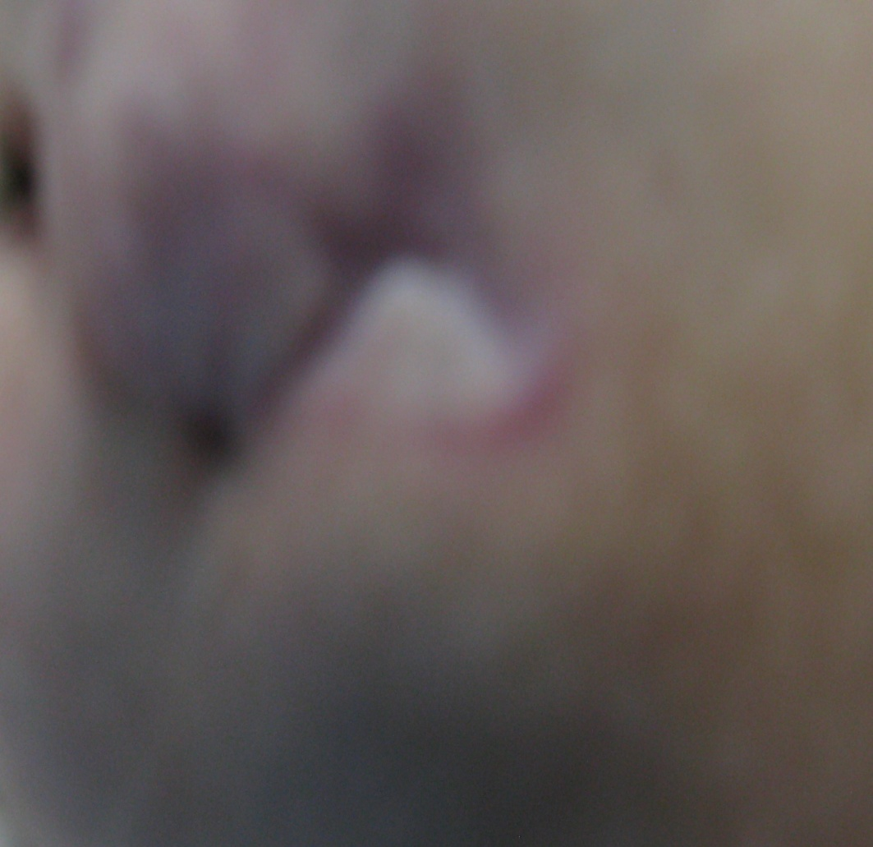

Tissue regeneration after 1 Week using Endothelial Progenitor Cell – from Wharton Jelly with Hypoxia methode Product - Cream

Slide 22

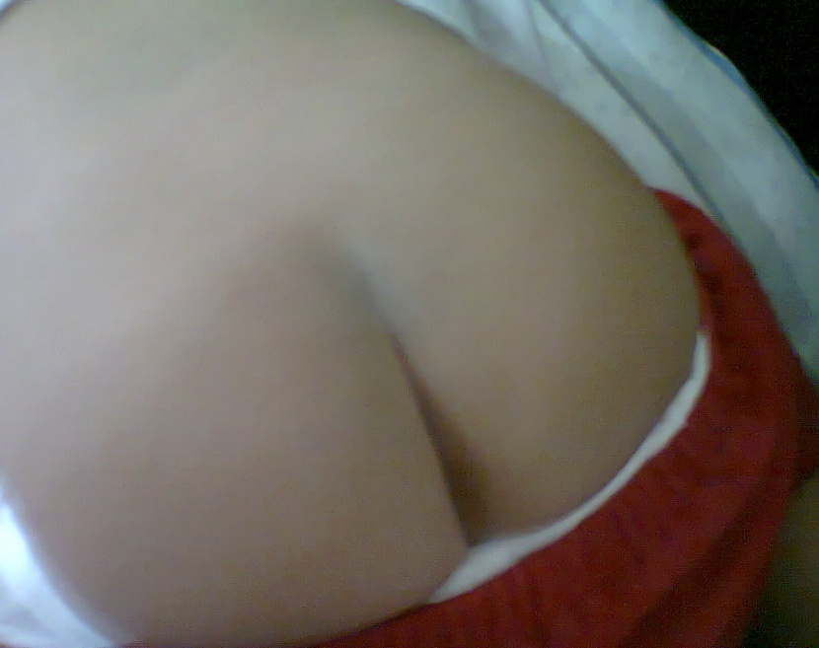
One week after
Fistula – Before
Therapy
1 Year after – no Scar

Slide 23

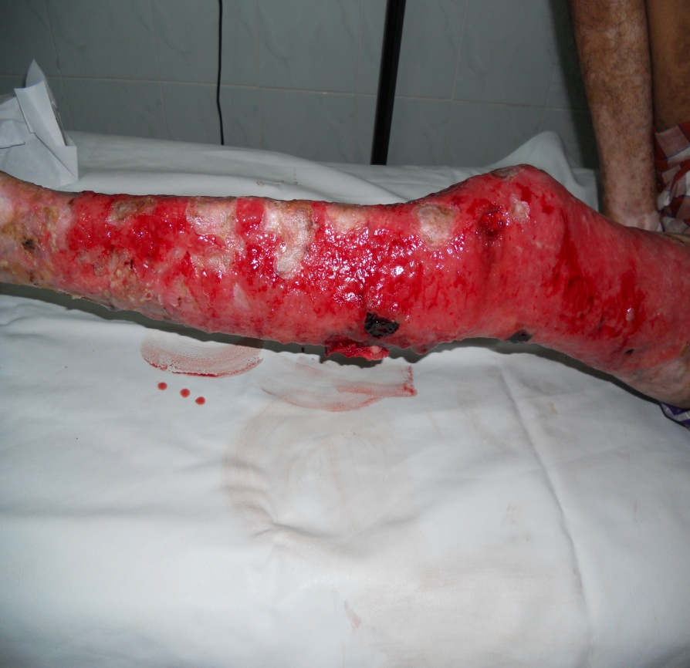
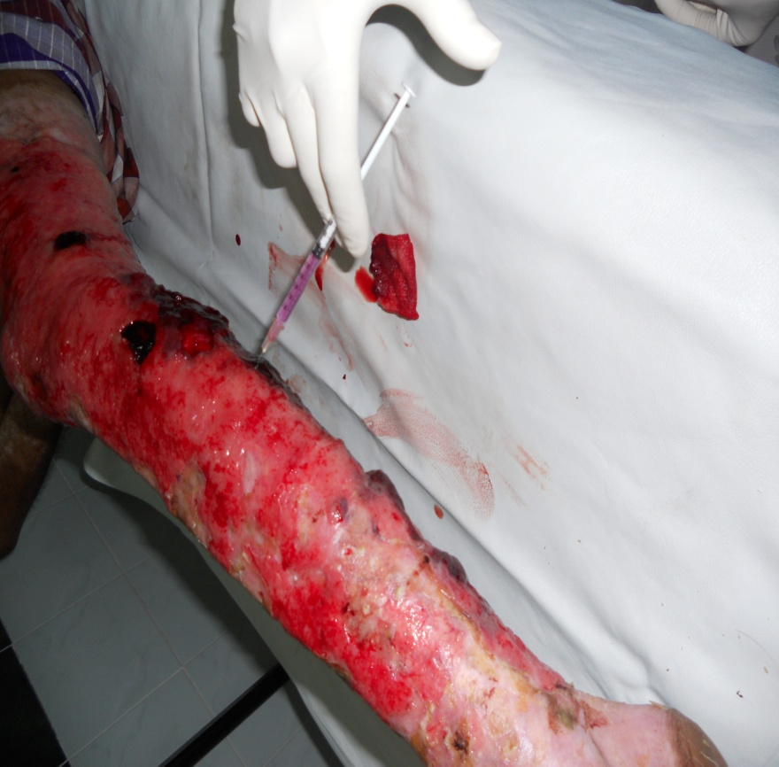
Male 23 yr, Combutio more than 5 months : Injections and Topical :
HUVECs (Spheroid and Hypoxia)

Slide 24
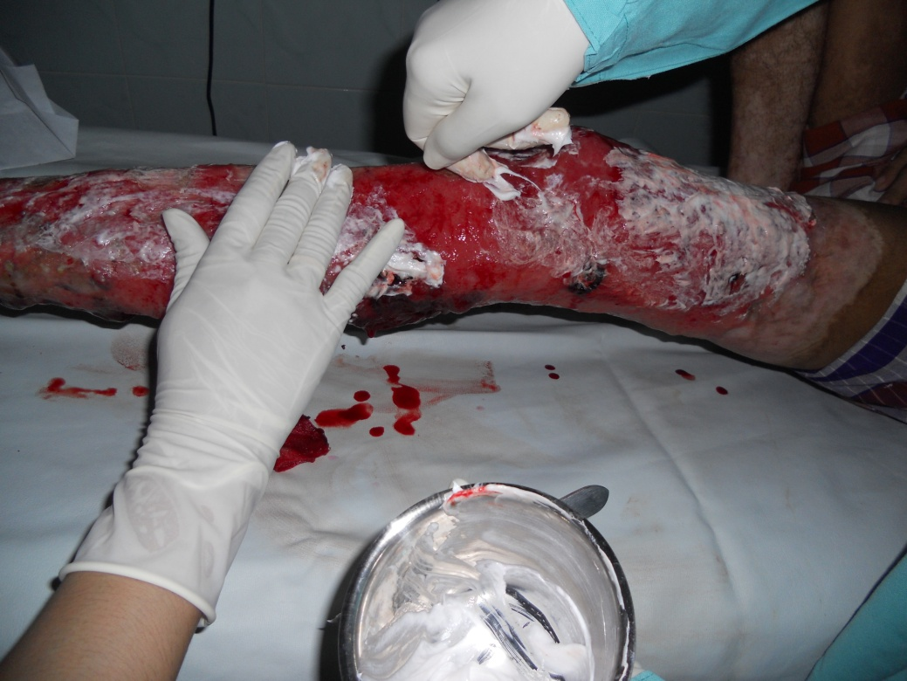
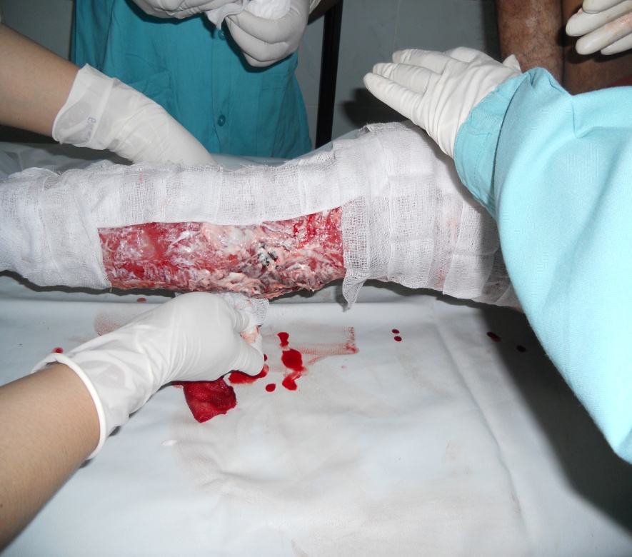
Author, give Mixed Gel & EPC - secretome

Slide 25
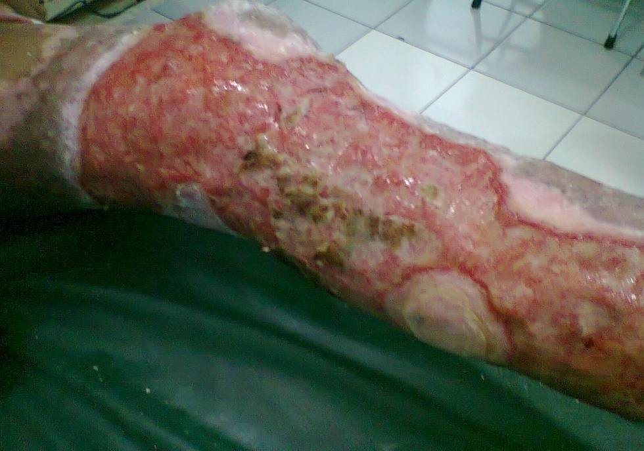
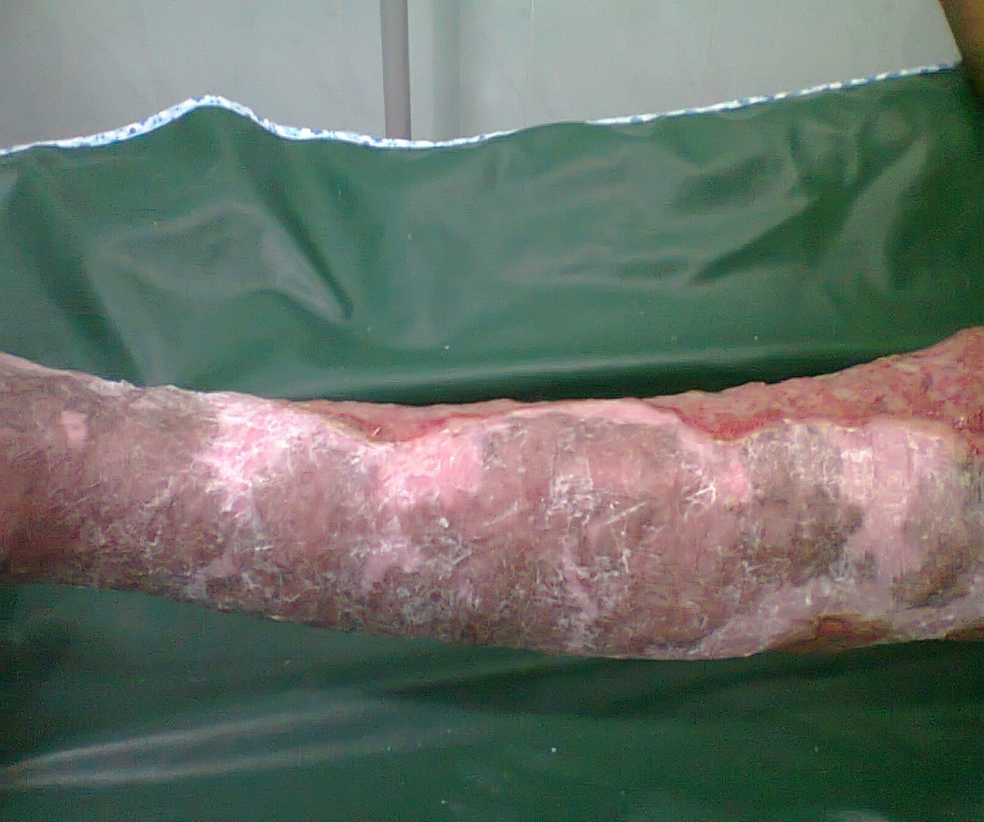
Starting to heal and without scar after 2 months

Slide 26
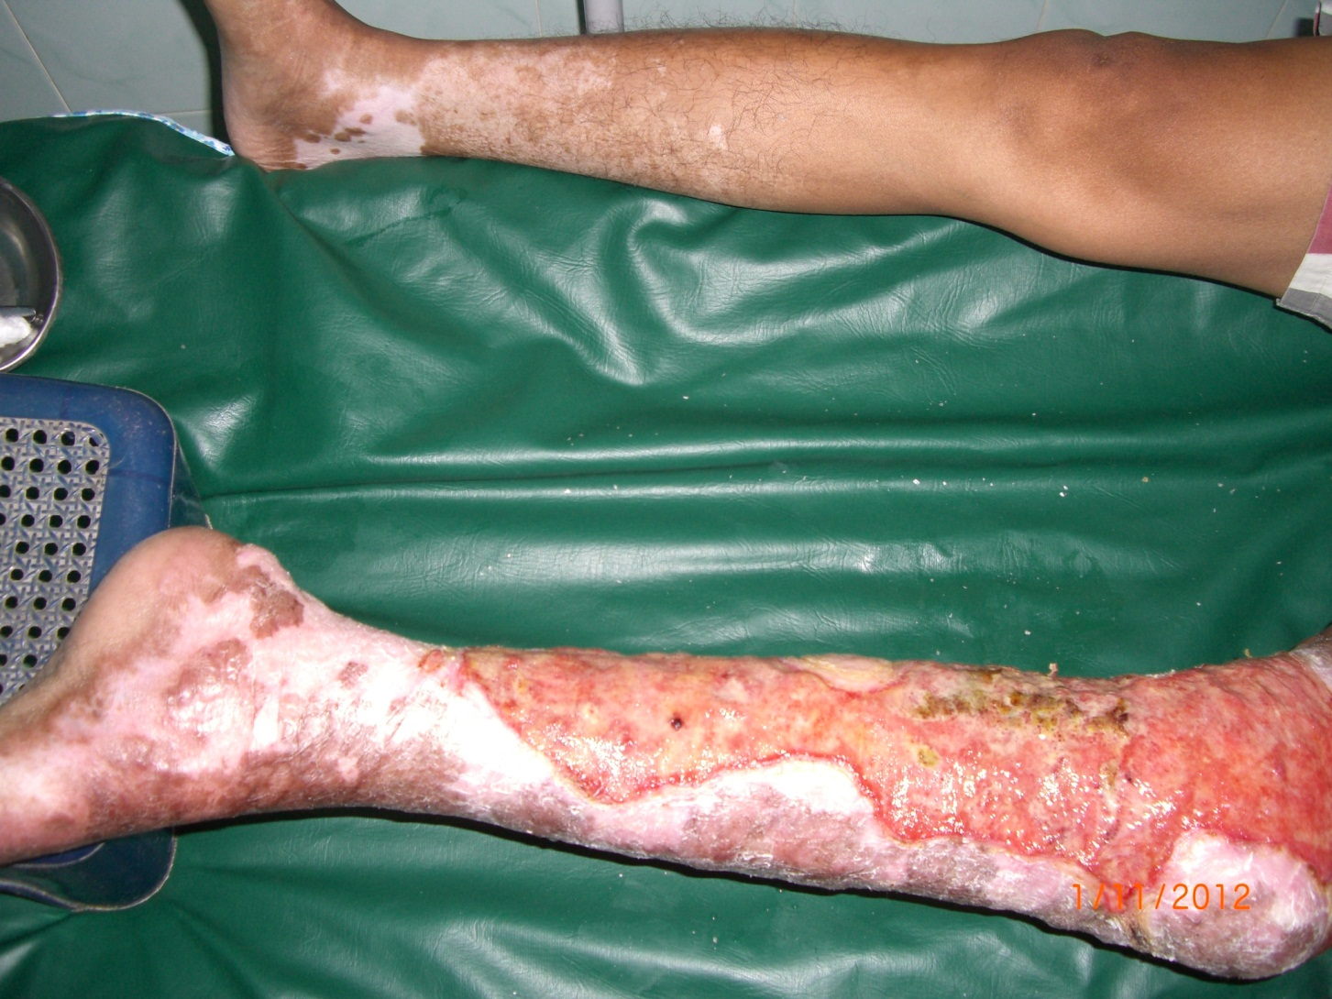
Regeneration in Right Foot

Slide 27

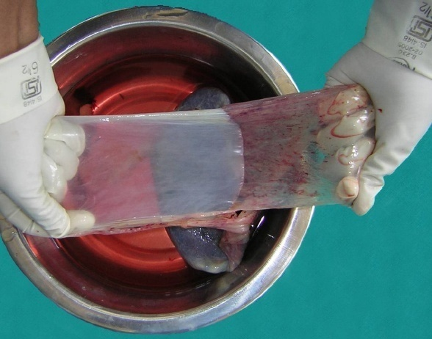
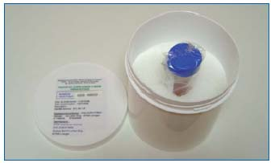
Peeling the amniotic membrane from the placenta
(Once again using Hypoxia methode)
Figure 1: Processing of amniotic membrane.

Slide 28
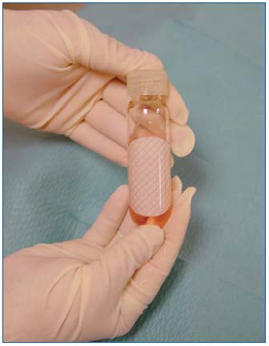
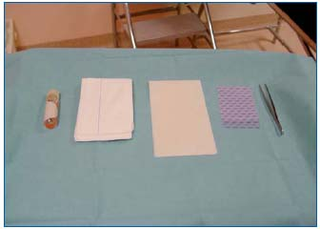
Preparation of the amniotic membrane and the wound dressing interface before placement of a wound dressing.
Amniotic membrane in its preserving fluid

Slide 29

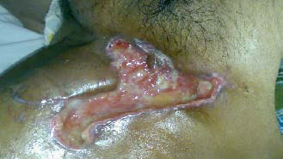
Non healing groin ulcer with exudation

Slide 30
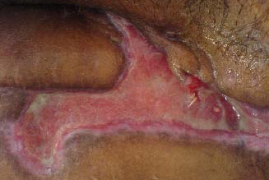
7 Day after AM dessing : No exudation

Slide 31
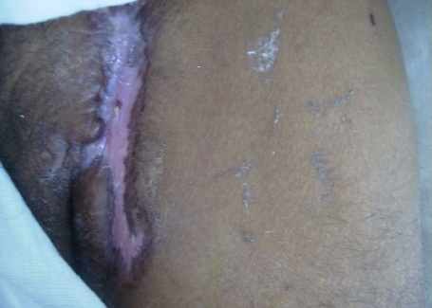
Three Weeks after AM Dressing

Slide 32
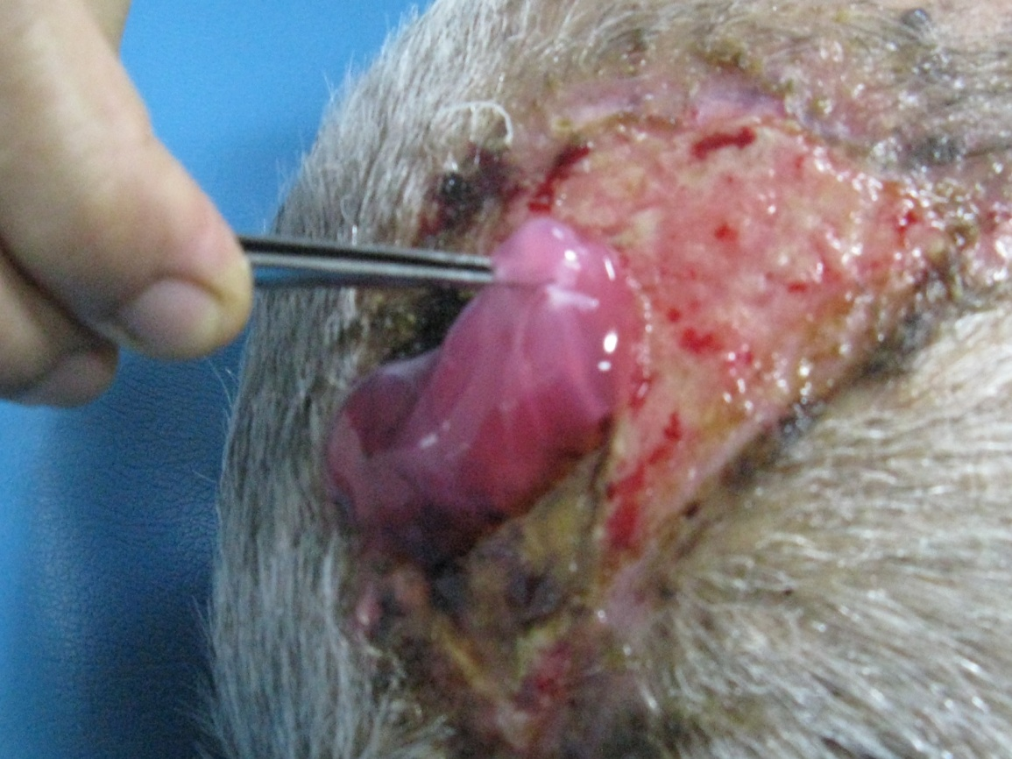
No healing ulcer (1 month) post op- Squamous Cell Carcinoma Surgery in Head (Male, 84 yr)
Placing AMNION

Slide 33
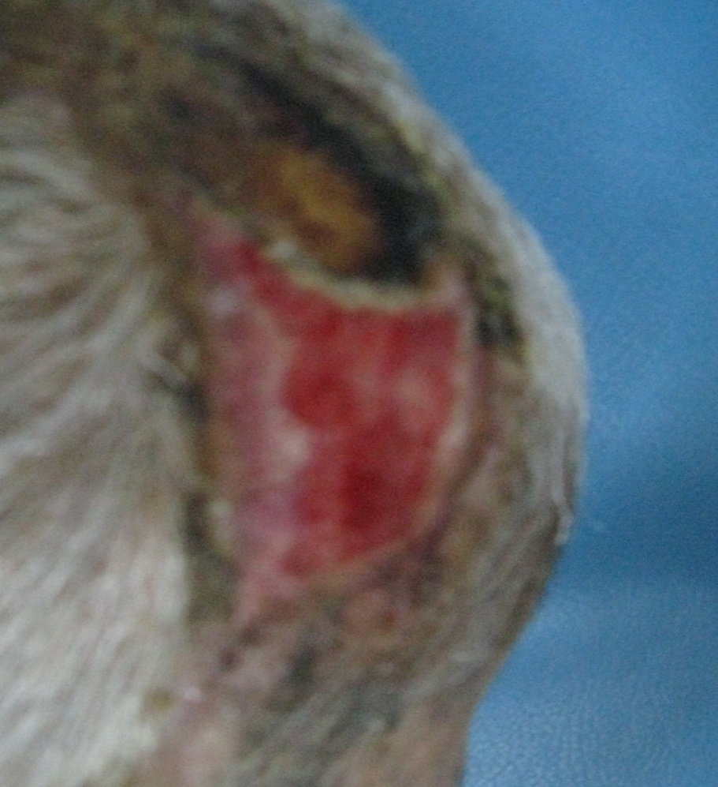
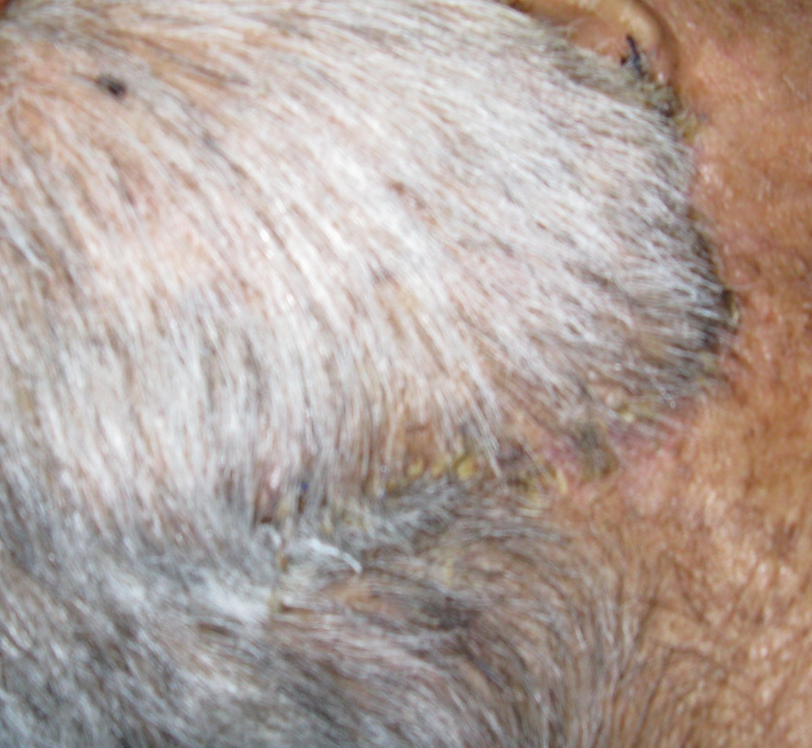
Wound Regeneration after 2 Surgeried : SCC and UNSECCESSFUL Dermagraft
Healing Process with renewal
damage tissue

Slide 34

Why Adipocyte Tissue ?

Slide 35
By definition, a stem cell is characterized by its ability to self-renew and its ability to differentiate along multiple lineage pathways.
Ideally, a stem cell for regenerative medicinal applications should meet the following criteria:
Regenerative Medicine :Uses the body’s own stem cells and growth factors is an alternative therapeutic strategy for repair of damage tissue, and becoming predominant cell base therapy

Slide 36
Regenerative medicinal applications should meet the following criteria:
Can be found in abundant quantities (millions to billions of cells)
Can be harvested by a minimally invasive procedure
Can be differentiated along multiple cell lineage pathways in a regulatable and reproducible manner.
Can be safely and effectively transplanted to either an autologous or allogeneic host

Slide 37
Human subcutaneous adipose tissue depots as a potential source of adult or somatic stem cells;
With the increased incidence of obesity in the Indonesia and abroad, subcutaneous adipose tissue is abundant and readily accessible.
Approximately 400,000 liposuction surgeries are performed all over the world each year,
These procedures yield anywhere from 100 mL to >3 L of lipoaspirate tissue

Slide 38
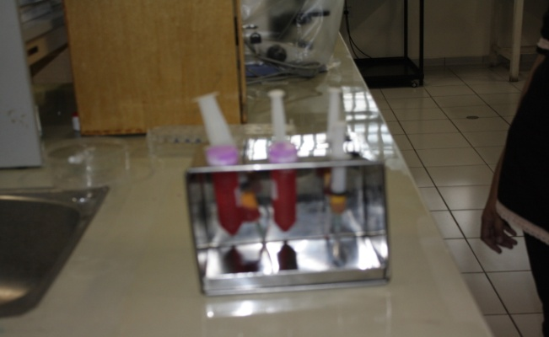
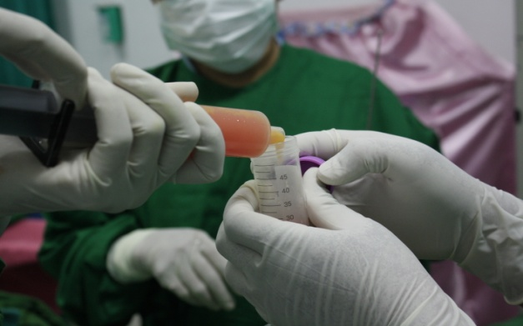
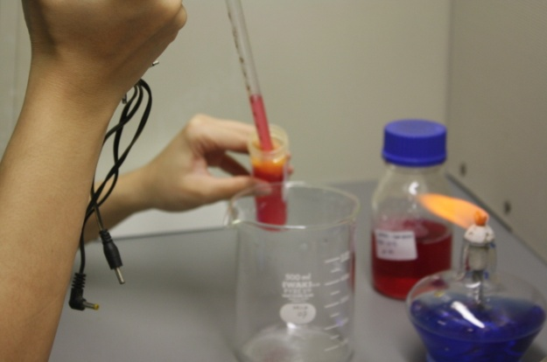
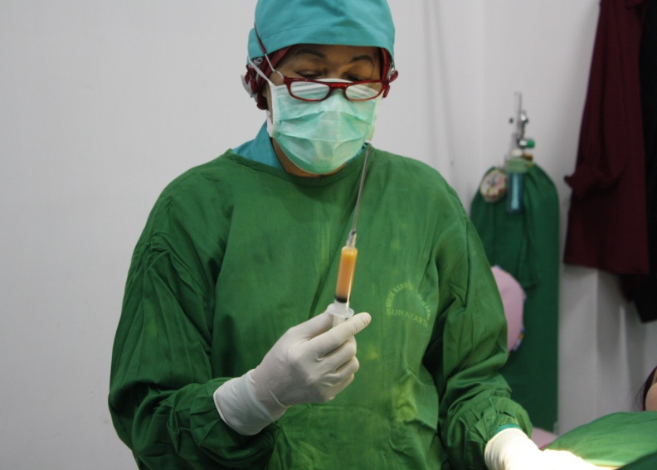
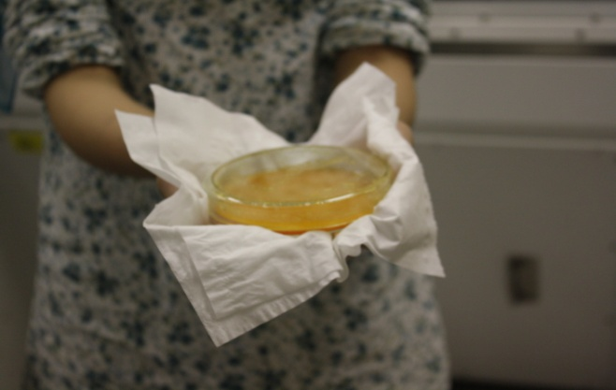
Hasil lemak dari liposuction

Slide 39
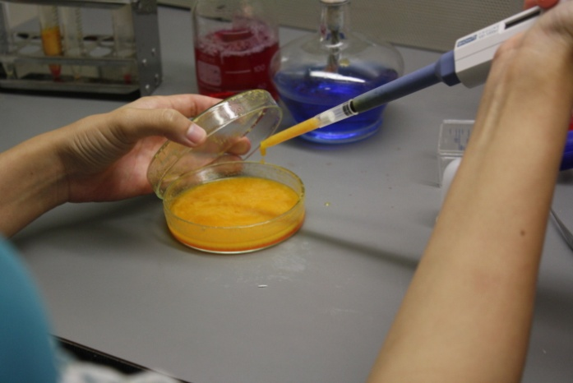
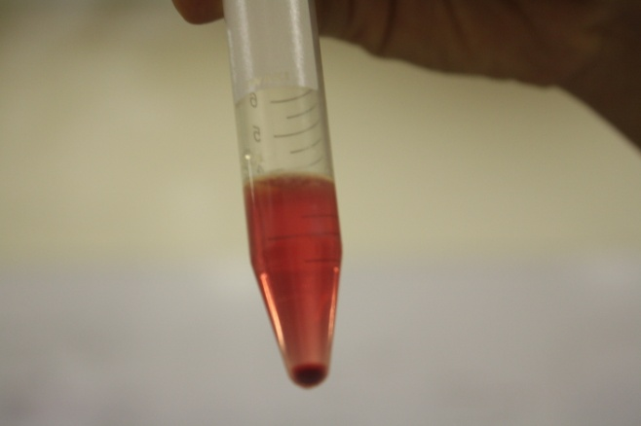
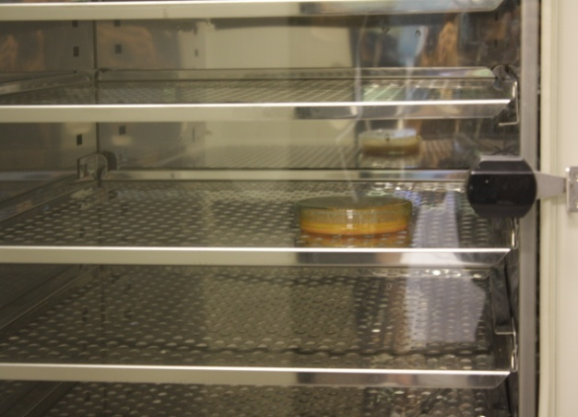
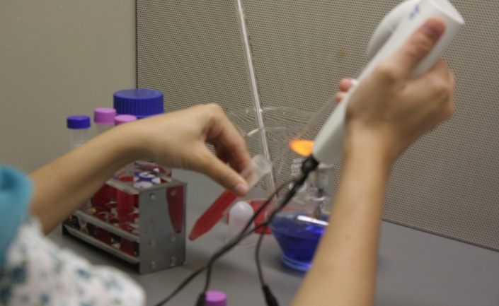
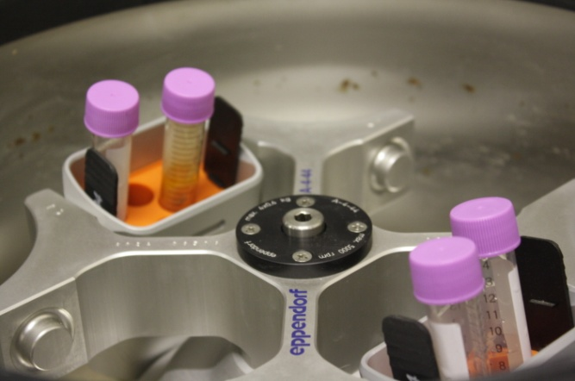
pellet

Slide 40
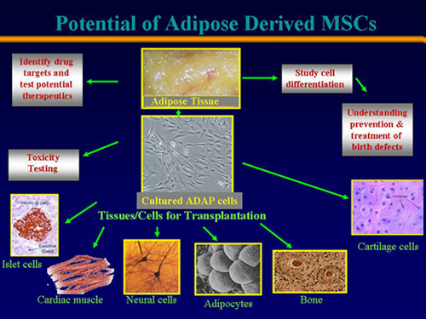

Slide 41
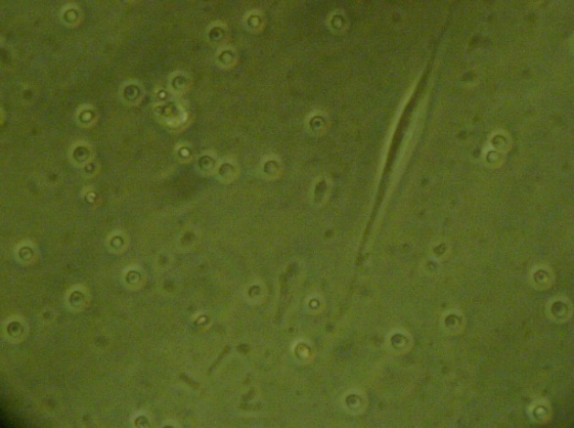
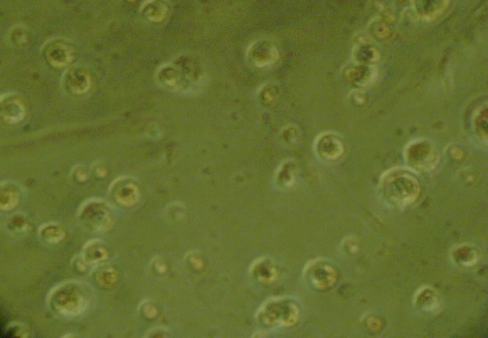
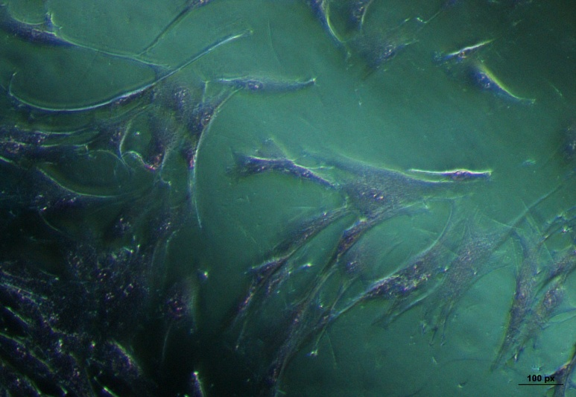
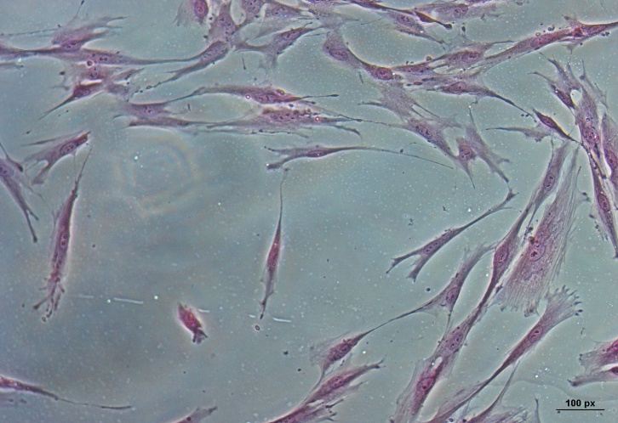
Adipocyte after 24 hours
Adipocyte after 24 hours
ADSC pasage 1 : hari ke 3

Slide 42
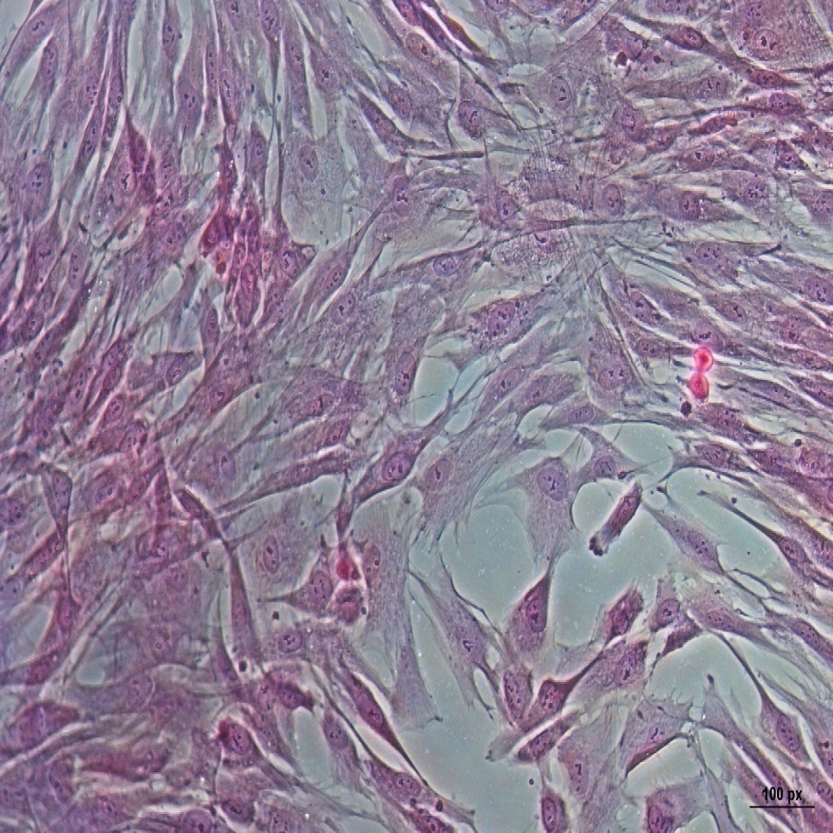
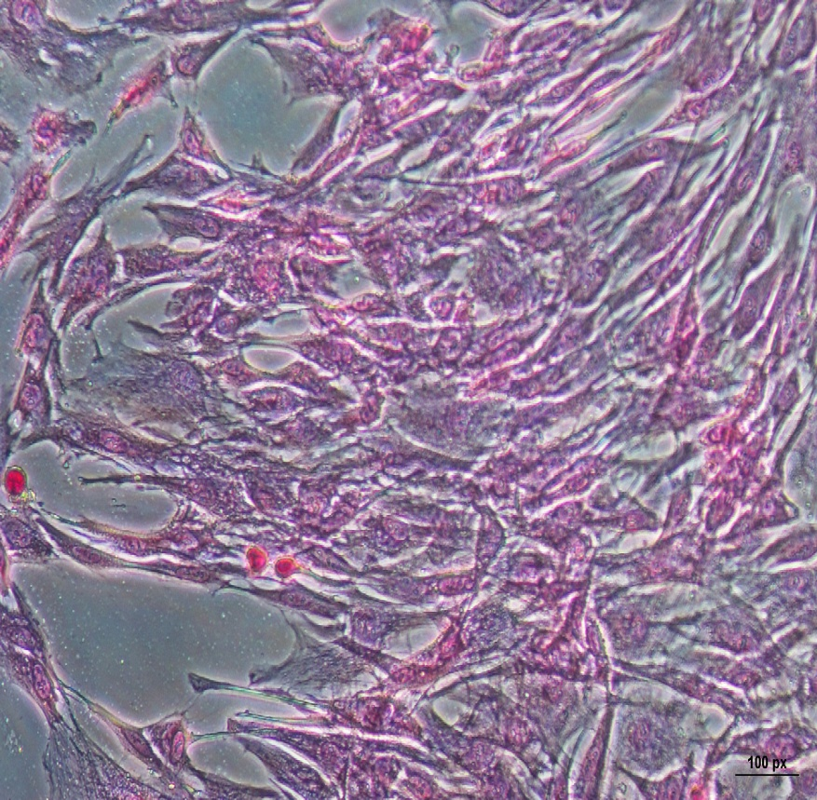
A. ADSCs hari ke 7 dan B. ADSC hari ke 14
A
B
by dr Indah Yulianto – Yuyun Rindiastuti

Slide 43
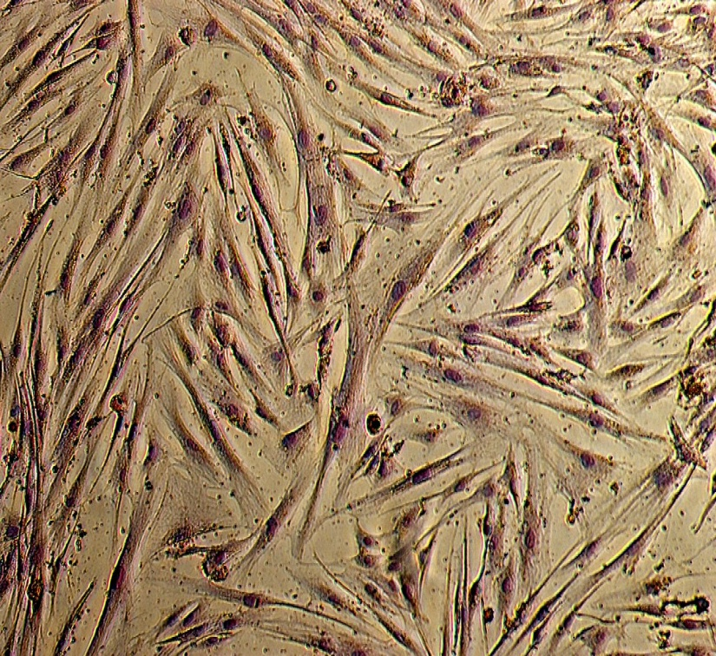
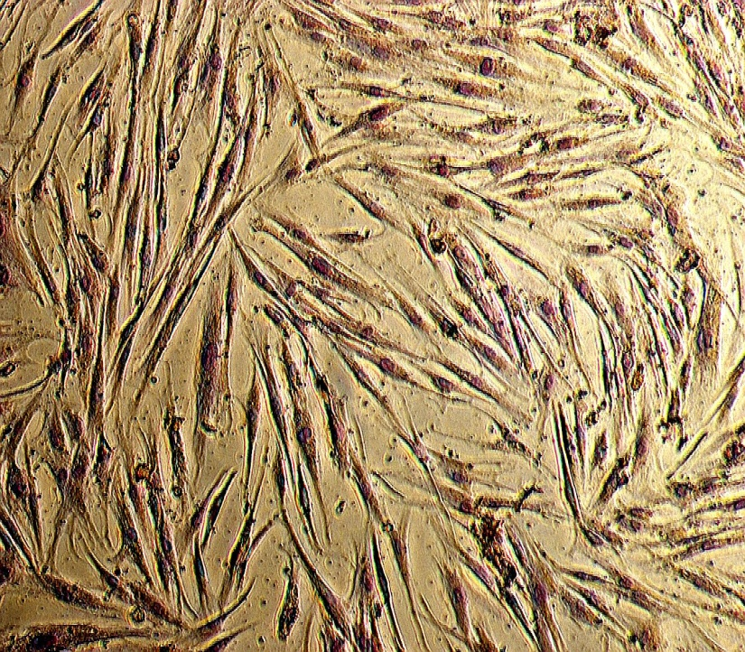
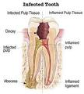
Transdifferensiasi ADSCs to Odontoblast
(immunocitokimia)
Ditujukan untuk regenerasi dan renewal Pulpitis
Courtesy by Indah Yulianto – Yuyun Rindiastuti – Dewi M

Slide 44

Preparing product Mesenchymal from Adipocyte Spheroid and Hanging Drop
From : Adipocyte, HUVEC & Umbilical Cord

Slide 45
ADSC which are a population of pluripotent mesenchymal cells and possess the ability to differentiate into various lineages
ADSCs secrete various growth factors that repair and replace the defective surrounding cells
Also a good raw material for skin regeneration, reepithelialization, wound healing and wrinkling care instead of ADSC itself

Slide 46
Characteristic differences observed between fetal and adult wound healing.
In adult humans :
Injured tissue is repaired by
collagen deposition, collagen remodeling and
eventual scar formation.
Whereas fetal wound :
Healing seems to be more of a regenerative process with minimal or no scar formation.

Slide 47
DISCUSSION
Promotes DNA damage & senescence
Chromosomal aberration during long term culture
Culture of mammalian cells at 20% oxygen
Importance of biosafety in cell therapy
Culture ADMSC at 3% 0xygen
              Increase growth rate
No evidence of spontaneous immortalization
reduce telomere shortening rate
decrease structural chromosomal aberration

Slide 48

Significant upregulation of gene expression in cells grown at 3% oxygen tension related to HIF 1A stabilization
Balance bioenergetics pattern
HIF 1A decreases OXPHOS system by downregulating mitochondrial ATP production & oxygen consumption
Autocrine & paracrine effect in cell growth & senescence
Implication of gene ontology analysis (HIF 1 dependent gene expression)

Slide 49
Analysis Method
Trypan blue stained cell counted by automatic cell counting machine (invitrogen)
Cell number & viability
MSC marker
CD 44, CD 106 PCR
Energy metabolism gene related glycolisis mechanism
HIF 1 A, HIF 1B, GLUT-1 PCR
Pluripotency marker
HIF 2A, Oct-4, Sox-2, Rex-1 PCR
Courtesy by Yuyun Rindiastuti

Slide 50
RESULT
Cell proliferation & viability
Cell number
Graph 1. Cell number profile

Slide 51
Cell viability
Graph 2. Cell viability
Courtesy By Yuyun RA

Slide 52

MSC surface marker expression

Slide 53

HIF 1A & GLUT 1 expression
Normoxic group
Hypoxic group
Courtesy By Yuyun RA

Slide 54




Alopecia Universalis : 1 month after MChSc and Product

Slide 55


Alopecia Universalis :1 month after MCSc + Product MSCc
By Indah Yulianto

Slide 56


After 2 Months

Slide 57


After :2 Months
By Indah Yulianto

Slide 58


After 4 months

Slide 59


Chronical Ucler diabeticum > 3 years
Day three, after injection with MSCHs product

Slide 60

1 week
1 month after Mesenchymal product ( Injections and Cream) – Men 74 years old
By Indah Yulianto

Slide 61


Acne Papulo pustular + Scar Acne : before and 1 week after AAPE

Slide 62


(3) Scar acne pasca skin needling + product &
(4) 1 week after skin needling + MCSs +_ Product
3
4

Slide 63


Acne Papulo Pustular + Scar
1 month after Skin Needling + MShCs
Courtesy by dr Titik Moertolo

Slide 64


3 days after skin needling + MCSs + product

Slide 65



Slide 66

Acne and Acne Scar
1 week After Skin Needling + MCSc + Product

Slide 67

Acne and Acne Scar
1 week After Skin Needling + MCSs + Product
Courtesy by Titik Moertolo

Slide 68


Leprosy after 30 years + 3 months burning ulcer + Infection
3 weeks after MSCs Product Injections + Cream
BY Indah Yulianto

Slide 69





Chronical Ulcer in M Hansen (Malperforan dupied) more than 20 years
Bone
1 week after
25 % reduce in 2 weeks
2 weeks after (painful & sensitivity +)

Slide 70



AMNIOTIC MEMBRANE DRESSING
PROMOTES EPITHELISATION & GRAANULATION + INJ EPC
1.5 MONTH AFTER

Slide 71

Terimakasih atas perhatiannya

